Slide 1

Slides Oefenzittingen komen op GitHub
github.com/JasperVisterin/Analyse-I-Oefenzittingen

Slide 2
Analyse I, Oefenzitting 8
Jasper.Visterin@kuleuven.be

Slide 3
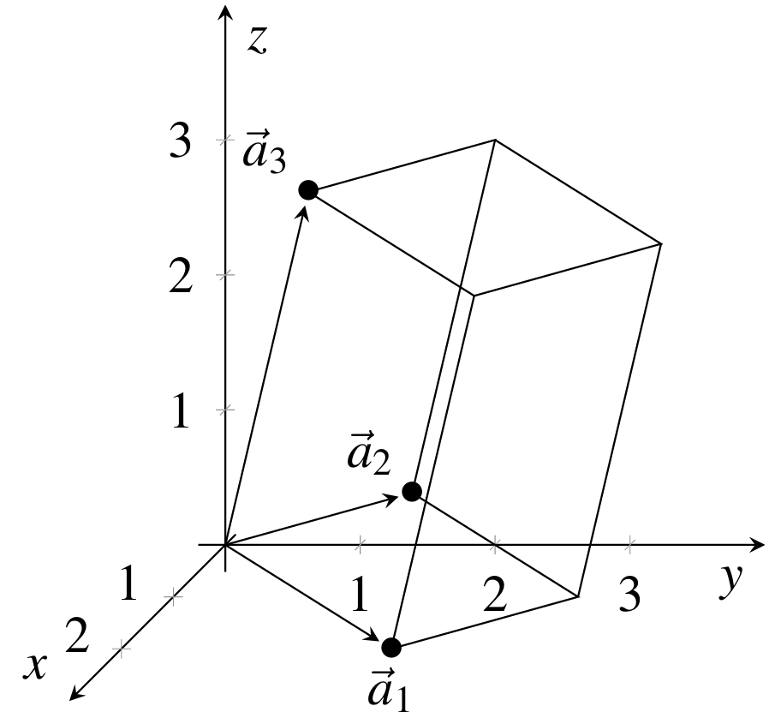
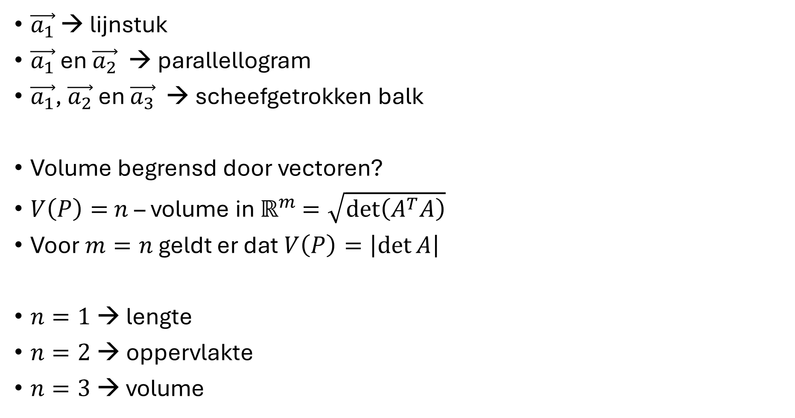
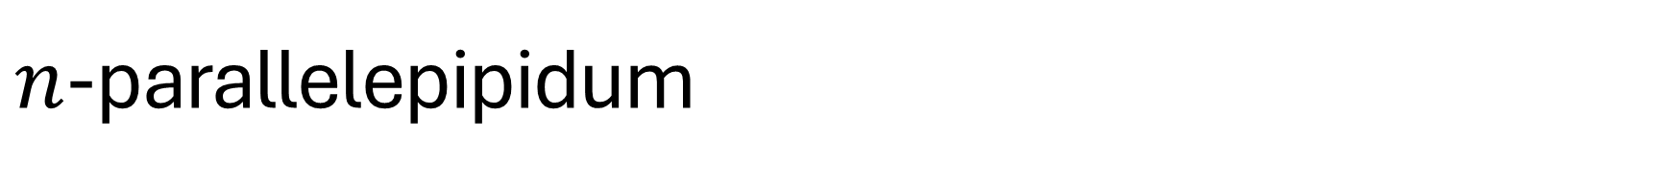

$n$-parallelepipidum
$\vec{a_{1}}$ → lijnstuk
$\vec{a_{1}}$ en $\vec{a_{2}}$ → parallellogram
$\vec{a_{1}}$, $\vec{a_{2}}$ en $\vec{a_{3}}$ → scheefgetrokken balk
Volume begrensd door vectoren?
$V\left(P\right)=$ $n$ – volume in $ℝ^{m}$ $=\sqrt{\det\left(A^{T}A\right)}$
Voor $m=n$ geldt er dat$V\left(P\right)=\left|\det{A}\right|$
$n=1$ → lengte
$n=2$ → oppervlakte
$n=3$ → volume
$$A=\left(\vec{a_{1}}\text{, }\vec{a_{2}},⋯,\vec{a_{n}}\right)$$

Slide 4
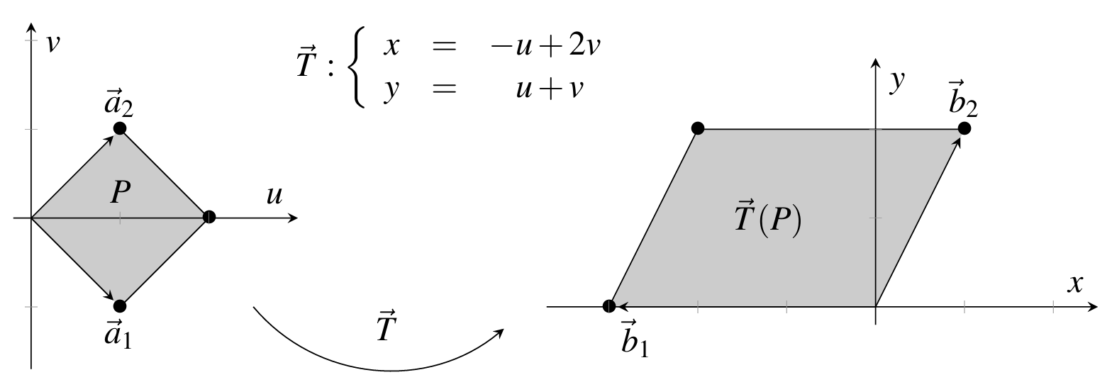



Volumeverandering bij Lineaire Transformatie
$\vec{T}:\left[\begin{aligned}x \\ y\end{aligned}\right]=\left[\begin{matrix}−1 & 2 \\ 1 & 1\end{matrix}\right]\left[\begin{aligned}u \\ v\end{aligned}\right]=M\left[\begin{aligned}u \\ v\end{aligned}\right]$
$V\left(\vec{T}\left(P\right)\right)=\left|\det{M A}\right|=\left|\det{M}\right|\left|\det{A}\right|=\left|\det{M}\right|V\left(P\right)$
Zie oppervlakte ellips
$$V\left(P\right)=2$$
$$V\left(\vec{T}\left(P\right)\right)=\left|\det{M}\right| V\left(P\right)=3⋅2=6$$

Slide 5
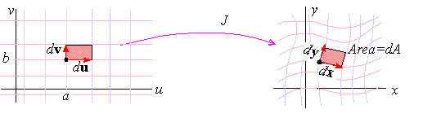
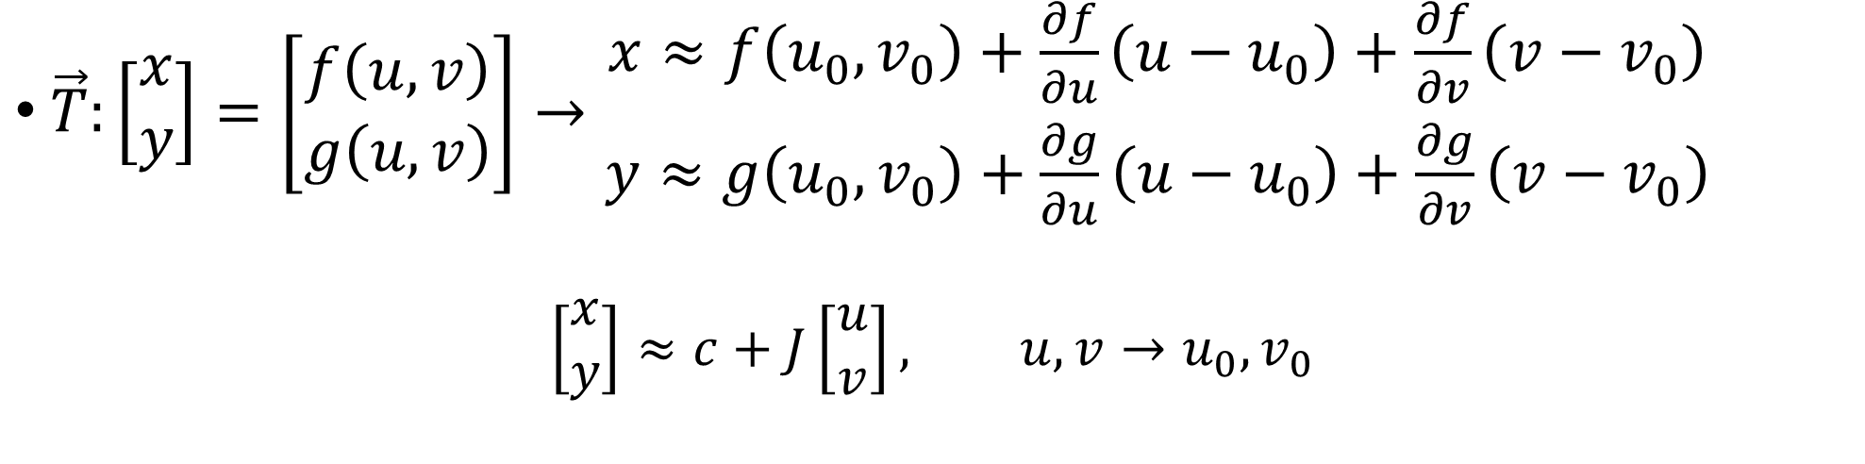

Volumeverandering bij Niet-Lineaire Transformatie
$$\vec{T}$$
$\vec{T}:\left[\begin{aligned}x \\ y\end{aligned}\right]=\left[\begin{aligned}f\left(u,v\right) \\ g\left(u,v\right)\end{aligned}\right]→\begin{aligned}x≈f\left(u_{0},v_{0}\right)+\frac{∂f}{∂u}\left(u−u_{0}\right)+\frac{∂f}{∂v}\left(v−v_{0}\right) \\ y≈g\left(u_{0},v_{0}\right)+\frac{∂g}{∂u}\left(u−u_{0}\right)+\frac{∂g}{∂v}\left(v−v_{0}\right)\end{aligned}$
$$\left[\begin{aligned}x \\ y\end{aligned}\right]≈c+J\left[\begin{aligned}u \\ v\end{aligned}\right], u,v→u_{0},v_{0}$$

Slide 6

Volumeverandering bij Niet-Lineaire Transformatie
$$\vec{T}$$
$$\left[\begin{aligned}dx \\ dy\end{aligned}\right]≈J\left[\begin{aligned}du \\ dv\end{aligned}\right], u,v→u_{0},v_{0}$$
$$V\left(\vec{T}\left(P\right)\right)=\left|\det{J}\right| V\left(P\right)$$
$$dA=dx dy=\left|\det{J}\right| du dv$$

Slide 7
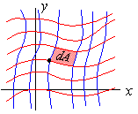
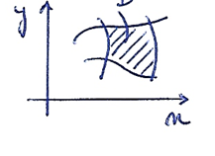




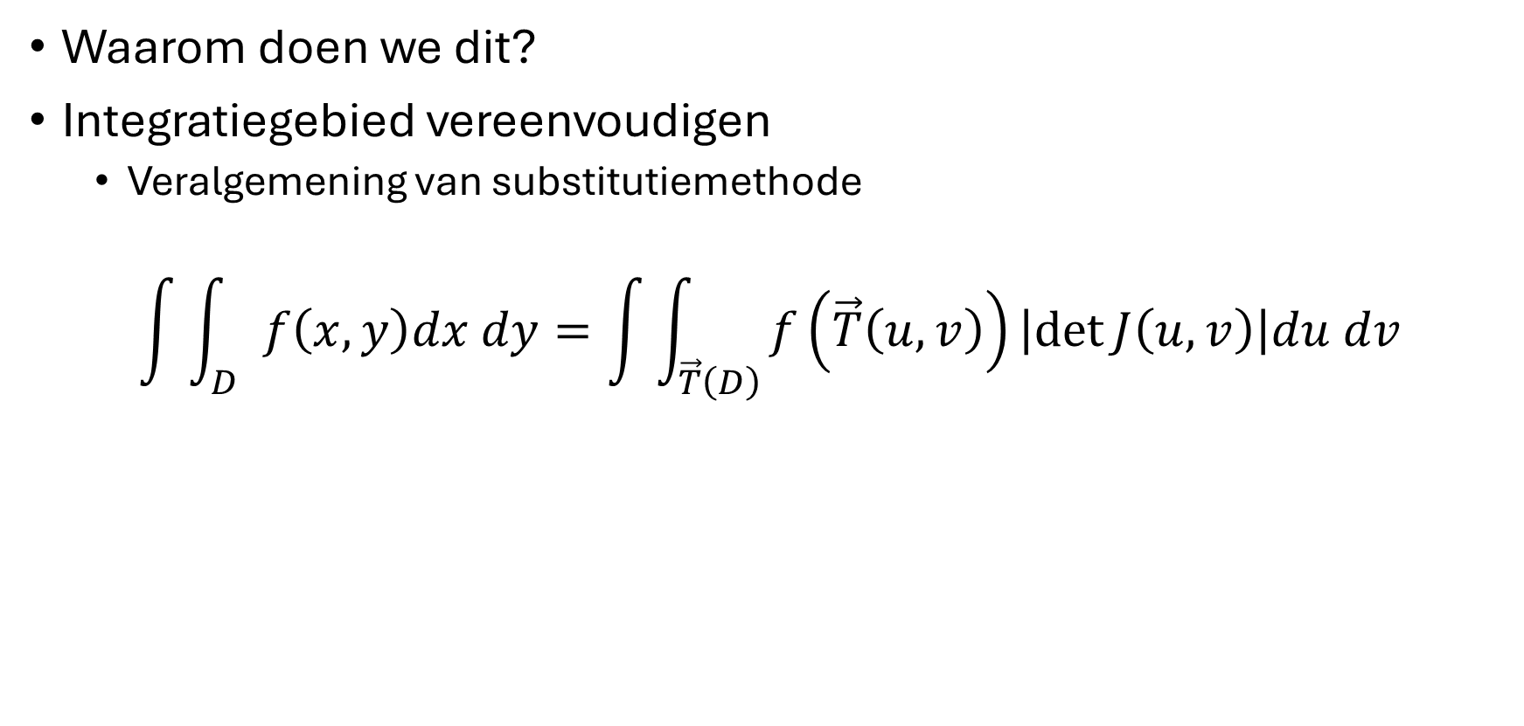





Transformatie van integratie veranderlijken
$$J\left(u,v\right)=\frac{∂\left(x,y\right)}{∂\left(u,v\right)}=\left(\begin{matrix}\frac{∂x}{∂u} & \frac{∂x}{∂v} \\ \frac{∂y}{∂u} & \frac{∂y}{∂v}\end{matrix}\right)$$
Waarom doen we dit?
Integratiegebied vereenvoudigen
  Veralgemening van substitutiemethode
$$\int{\int_{D}{f\left(x,y\right)dx dy}}=\int{\int_{\vec{T}\left(D\right)}{f\left(\vec{T}\left(u,v\right)\right)\left|\det{J\left(u,v\right)}\right|du dv}}$$
$$\vec{T}:\left\{\begin{aligned}x=T_{1}\left(u,v\right) \\ y=T_{2}\left(u,v\right)\end{aligned}\right.$$
$$v$$
$$v_{2}$$
$$v_{1}$$
$${\vec{T}}^{−1}:\left\{\begin{aligned}u=T_{1}^{−1}\left(x,y\right) \\ v=T_{2}^{−1}\left(x,y\right)\end{aligned}\right.$$
$$u_{1}$$
$$u_{2}$$
$$u$$

Slide 8
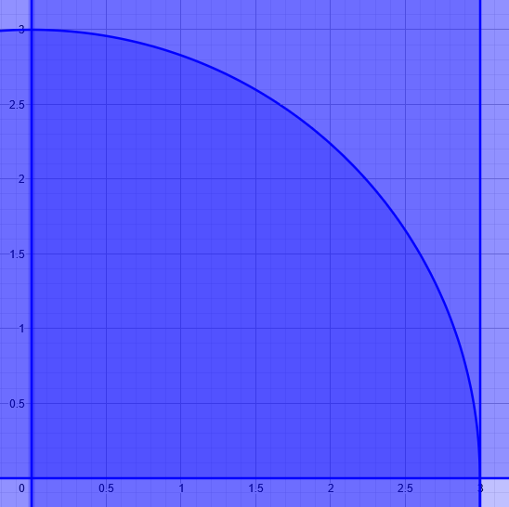
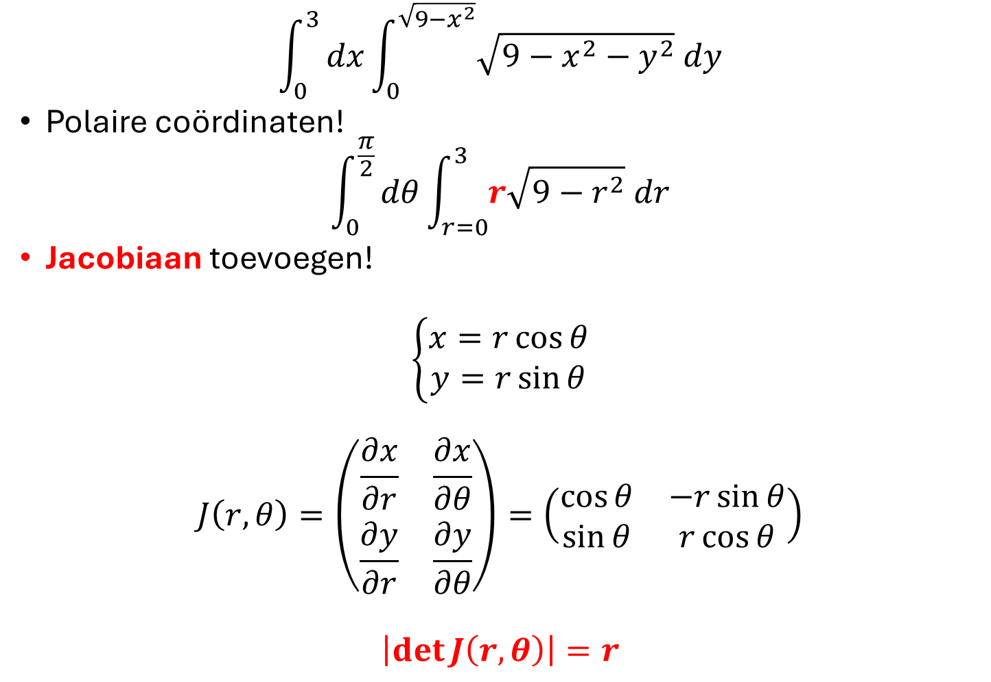

Voorbeeld
$$\int_{0}^{3}{dx\int_{0}^{\sqrt{9−x^{2}}}{\sqrt{9−x^{2}−y^{2}} dy}}$$
Polaire coördinaten!
$$\int_{0}^{\frac{π}{2}}{dθ\int_{r=0}^{3}{r\sqrt{9−r^{2}} dr}}$$
Jacobiaan toevoegen!
$$\left\{\begin{aligned}x=r\cos{θ} \\ y=r\sin{θ}\end{aligned}\right.$$
$$J\left(r,θ\right)=\left(\begin{matrix}\frac{∂x}{∂r} & \frac{∂x}{∂θ} \\ \frac{∂y}{∂r} & \frac{∂y}{∂θ}\end{matrix}\right)=\left(\begin{matrix}\cos{θ} & −r\sin{θ} \\ \sin{θ} & r\cos{θ}\end{matrix}\right)$$
$$\left|\det{J\left(r,θ\right)}\right|=r$$
$$D$$

Slide 9
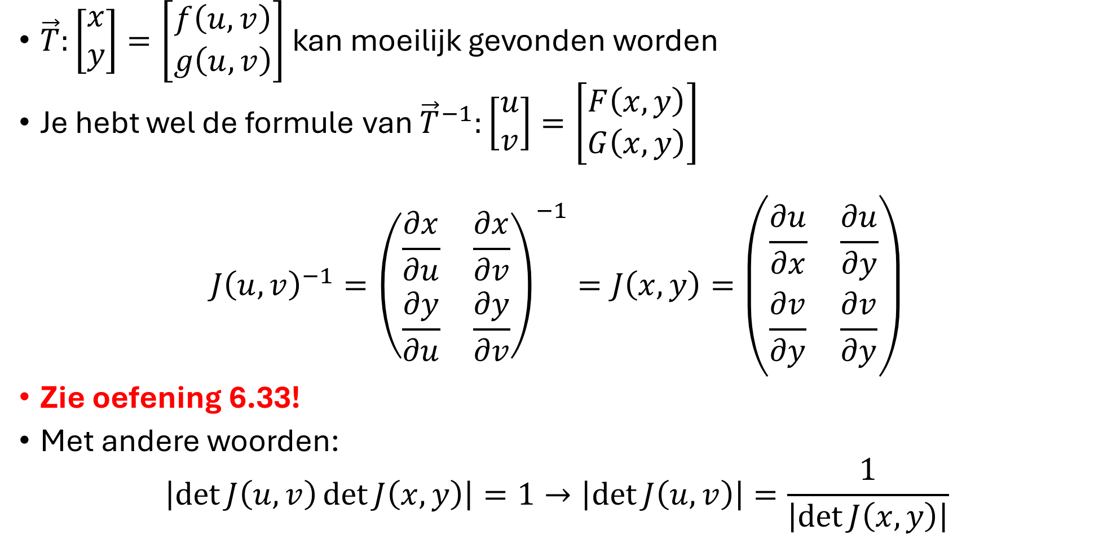

Wat als $\vec{T}$ moeilijk te bepalen is?
$\vec{T}:\left[\begin{aligned}x \\ y\end{aligned}\right]=\left[\begin{aligned}f\left(u,v\right) \\ g\left(u,v\right)\end{aligned}\right]$ kan moeilijk gevonden worden
Je hebt wel de formule van ${\vec{T}}^{−1}:\left[\begin{aligned}u \\ v\end{aligned}\right]=\left[\begin{aligned}F\left(x,y\right) \\ G\left(x,y\right)\end{aligned}\right]$
$$J{\left(u,v\right)}^{−1}={\left(\begin{matrix}\frac{∂x}{∂u} & \frac{∂x}{∂v} \\ \frac{∂y}{∂u} & \frac{∂y}{∂v}\end{matrix}\right)}^{−1}=J\left(x,y\right)=\left(\begin{matrix}\frac{∂u}{∂x} & \frac{∂u}{∂y} \\ \frac{∂v}{∂y} & \frac{∂v}{∂y}\end{matrix}\right)$$
Zie oefening 6.33!
Met andere woorden:
$$\left|\det{J\left(u,v\right)}\det{J\left(x,y\right)}\right|=1→\left|\det{J\left(u,v\right)}\right|=\frac{1}{\left|\det{J\left(x,y\right)}\right|}$$

Slide 10
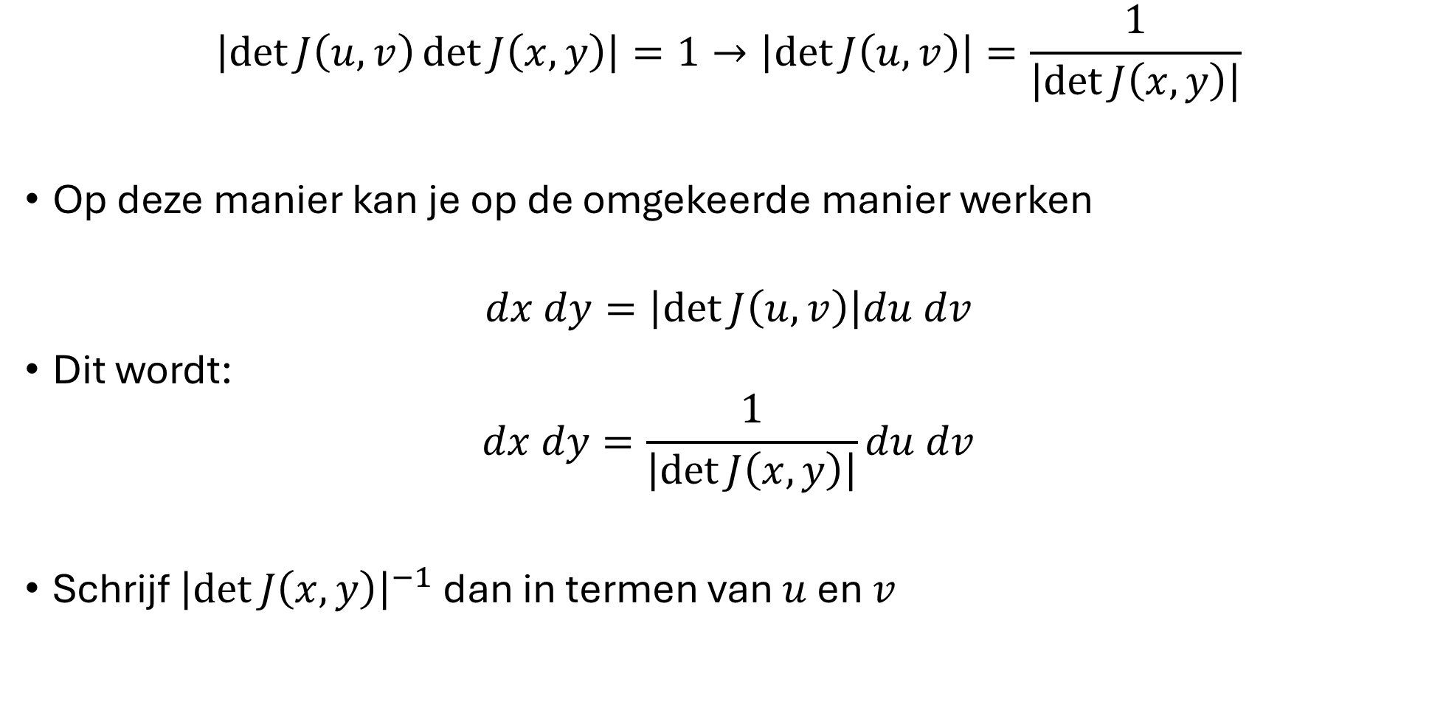
Wat als $\vec{T}$ moeilijk te bepalen is?
$$\left|\det{J\left(u,v\right)}\det{J\left(x,y\right)}\right|=1→\left|\det{J\left(u,v\right)}\right|=\frac{1}{\left|\det{J\left(x,y\right)}\right|}$$
Op deze manier kan je op de omgekeerde manier werken
$$dx dy=\left|\det{J\left(u,v\right)}\right|du dv$$
Dit wordt:
$$dx dy=\frac{1}{\left|\det{J\left(x,y\right)}\right|}du dv$$
Schrijf ${\left|\det{J\left(x,y\right)}\right|}^{−1}$ dan in termen van $u$ en $v$

Slide 11
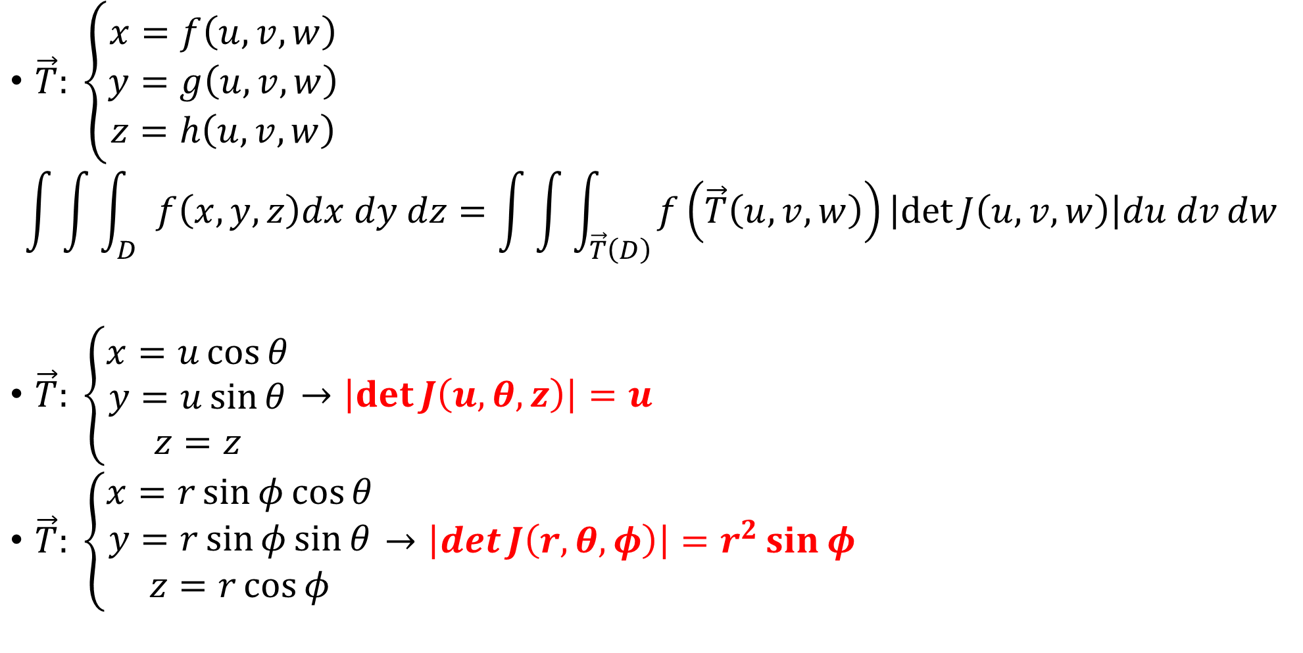


Wat als we dit willen toepassen voor $ℝ^{3}$ ?
$\vec{T}: \left\{\begin{aligned}x=f\left(u,v,w\right) \\ y=g\left(u,v,w\right) \\ z=h\left(u,v,w\right)\end{aligned}\right.$
$$\int{\int{\int_{D}{f\left(x,y,z\right)dx dy dz}}}=\int{\int{\int_{\vec{T}\left(D\right)}{f\left(\vec{T}\left(u,v,w\right)\right)\left|\det{J\left(u,v,w\right)}\right|du dv}dw}}$$
$\vec{T}: \left\{\begin{aligned}x=u\cos{θ} \\ y=u\sin{θ} \\ z=z\end{aligned}\right.→\left|\det{J\left(u,θ,z\right)}\right|=u$
$\vec{T}: \left\{\begin{aligned}x=r\sin{φ}\cos{θ} \\ y=r\sin{φ}\sin{θ} \\ z=r\cos{φ}\end{aligned}\right.→\left|\det{J\left(r,θ,φ\right)}\right|=r^{2}\sin{φ}$
$$J\left(u,v,w\right)=\frac{∂\left(x,y,z\right)}{∂\left(u,v,w\right)}=\left(\begin{matrix}\frac{∂x}{∂u} & \frac{∂x}{∂v} & \frac{∂x}{∂w} \\ \frac{∂y}{∂u} & \frac{∂y}{∂v} & \frac{∂y}{∂w} \\ \frac{∂z}{∂w} & \frac{∂z}{∂w} & \frac{∂z}{∂w}\end{matrix}\right)$$

Slide 12

$$\int{\int{\int_{D}{f\left(x,y,z\right)dx dy dz}}}=\int{\int{\int_{\vec{T}\left(D\right)}{f\left(\vec{T}\left(u,v,w\right)\right)\left|\det{J\left(u,v,w\right)}\right|du dv}dw}}$$

Slide 13
Oefeningen
8.5 F
8.6 D
8.9 O
8.12 O → ENKEL INTEGRAAL OPSTELLEN
8.18 → ENKEL INTEGRAAL OPSTELLEN
8.24 B → ENKEL INTEGRAAL OPSTELLEN

